Slide 1
React Ecosystem
Mohan Ram

Slide 2
Agenda
ECMAScript 6
React
Flux Pattern
Redux
Webpack
  Build tool [No task runner codes, only configurations]
  Loaders (Example - CSS Loader, Style Loader, Coffee, Typescript)
  Plug-in (Example - Hot Module Replacement)
  Webpack development server

Slide 3
ECMAScript 6
The ECMAScript specification is a standardized specification of a scripting language developed by Brendan Eich.
ECMAScript 6, also known as ECMAScript 2015, is the latest version of the ECMAScript standard.
Babel and Traceur is a JavaScript Compiler. It has support for the latest version of JavaScript through syntax transformers. These plug-in allow you to use new syntax, right now without waiting for browser support.

Slide 4
ECMAScript 6 Features
Let + Const
Arrows
Classes
Modules
Spread Operator

Slide 5
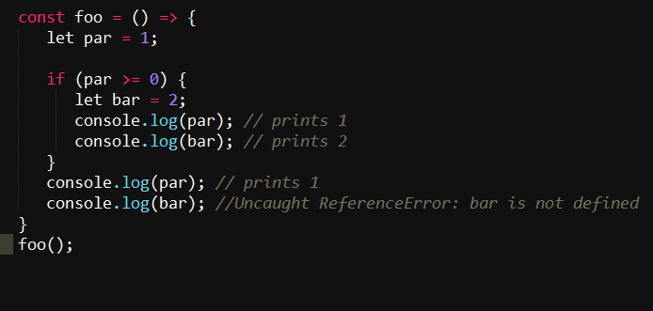
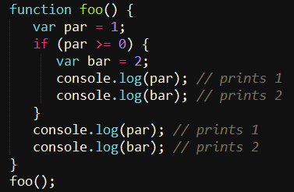
Let + Const

Slide 6
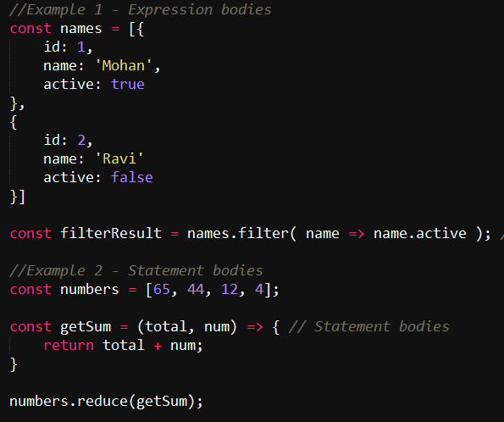
Arrows

Slide 7
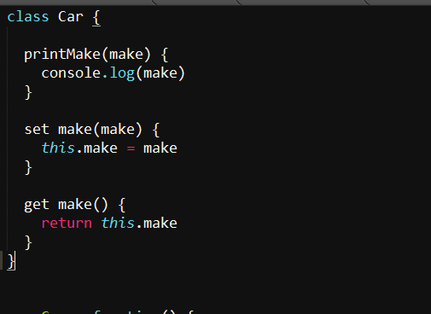
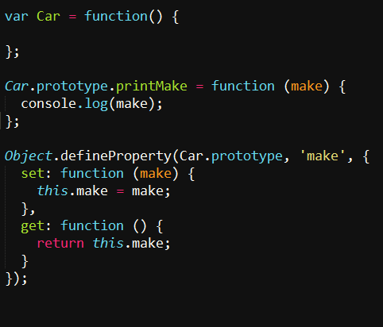
Classes

Slide 8
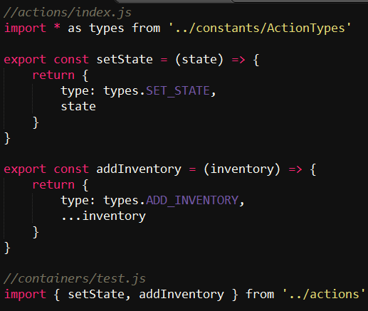
Modules

Slide 9
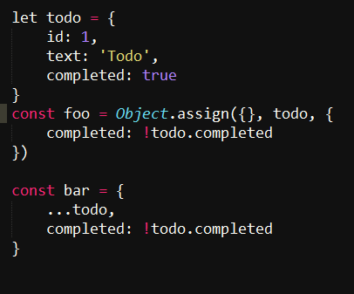
Spread Operator

Slide 10
React
React is a open source JavaScript Library from Facebook.
React builds encapsulated components that manage their own state, then compose them to make complex UIs. Data flows down.
React components are very simple. You can think of them as simple functions that take in props & state and render HTML. With this in mind, components are easy to reason about.
Its used by Facebook, Instagram, Netflix, Dropbox etc.

Slide 11
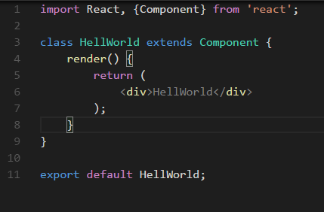
Hello World

Slide 12
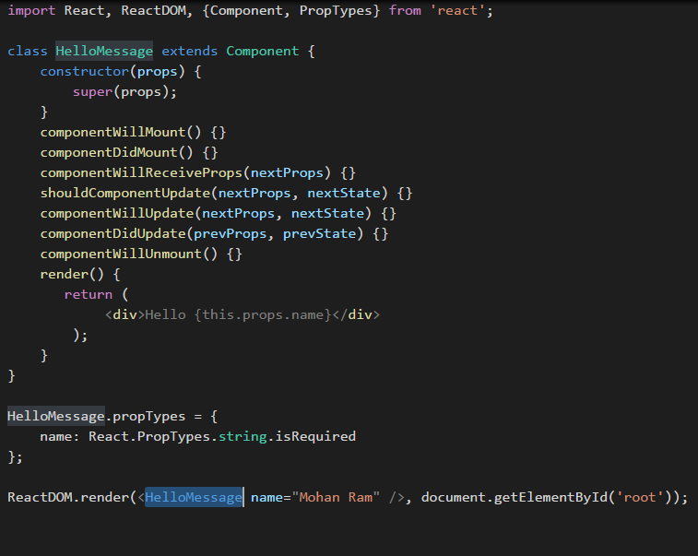

Slide 13
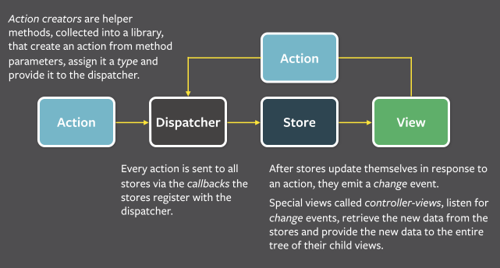
Flux Pattern

Slide 14
Flux Concept
The dispatcher, stores and views are independent nodes with distinct inputs and outputs.
Actions are payloads of information that send data from your application to your store. They are the only source of information for the store (Plain Object).
Dispatcher is the central hub that manages all data flow in a Flux application. It is essentially a registry of callbacks into the stores.
Stores contain the application state and logic. Their role is somewhat similar to a model in a traditional MVC, but they manage the state of many objects.

Slide 15
Reducer + Flux = Redux
Reducer - (state, action) => state
Redux was inspired by several important qualities of Flux.
Like Flux, Redux prescribes that you concentrate your model update logic in a certain layer of your application (“stores” in Flux, “reducers” in Redux).
Redux does not have the concept of a Dispatcher. This is because it relies on pure functions instead of event emitters.
Redux assumes you never mutate your data. You can use plain objects and arrays for your state just fine, but mutating them inside the reducers is strongly discouraged. You should always return a new object, which is easy with the object spread proposal, or with a library like Immutable.

Slide 16
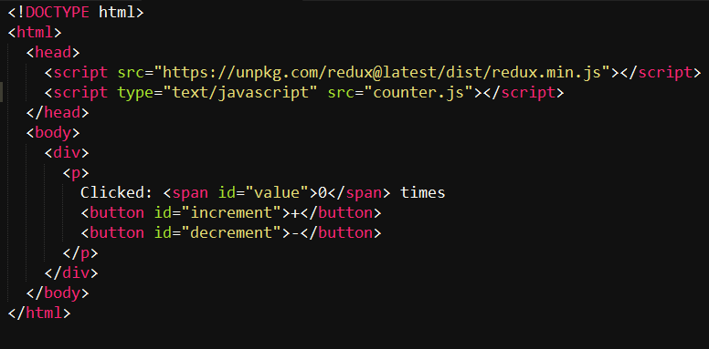
Counter Example

Slide 17
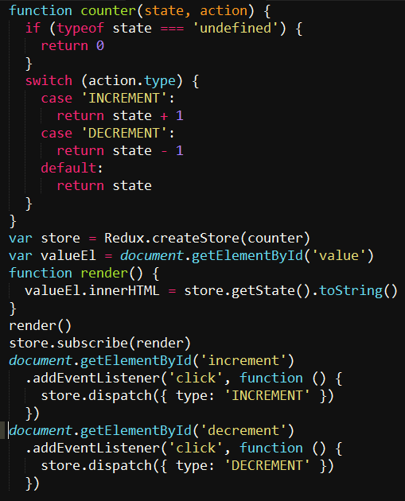

Slide 18

Credits from Facebook

Slide 19
?
Thank you

